Slide 1


DATATECH LABS.
Data Engineering Course.
Week 1

Slide 2
Outline: Week 1
Overview of Data Engineering
Role of a Data Engineer
Data Lifecycle
Data Modeling Concepts
Data Warehouse Architecture
Data Lake Architecture
DATATECH LABS.

Slide 3
Introduction to Data Engineering & Data Modeling
DATATECH LABS.

Slide 4
What is Data Engineering
DATATECH LABS.

Slide 5
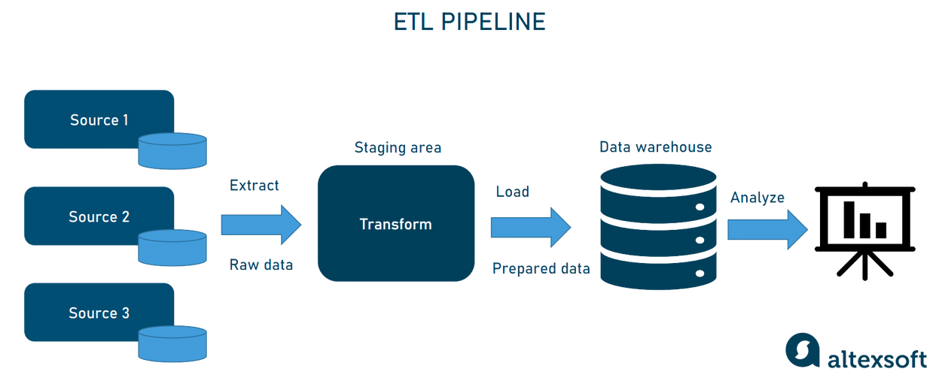
What is Data Engineering?
Definition: Data Engineering is the process of designing and building systems that allow for the collection, storage, and analysis of large datasets.
Discussion Point: Why is data engineering important in today’s data-driven world?
DATATECH LABS.

Slide 6
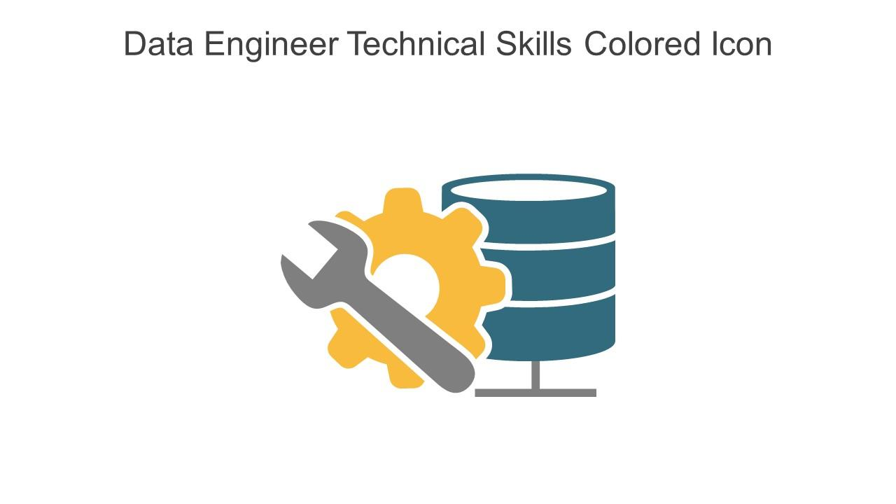
The Role of a Data Engineer
Responsibilities:
Designing data pipelines
Building data infrastructure
Data collection and integration
Ensuring data quality and consistency
Discussion Point: How does the role of a data engineer differ from a data scientist?
DATATECH LABS.

Slide 7
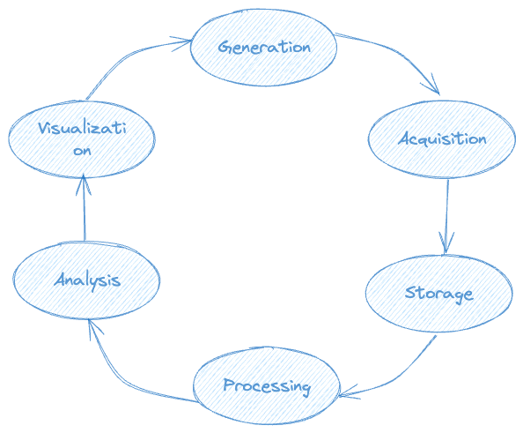
The Data Lifecycle
Data Generation
Data Acquisition
Data Storage
Data Processing
Data Analysis
Data Visualization
DATATECH LABS.

Slide 8
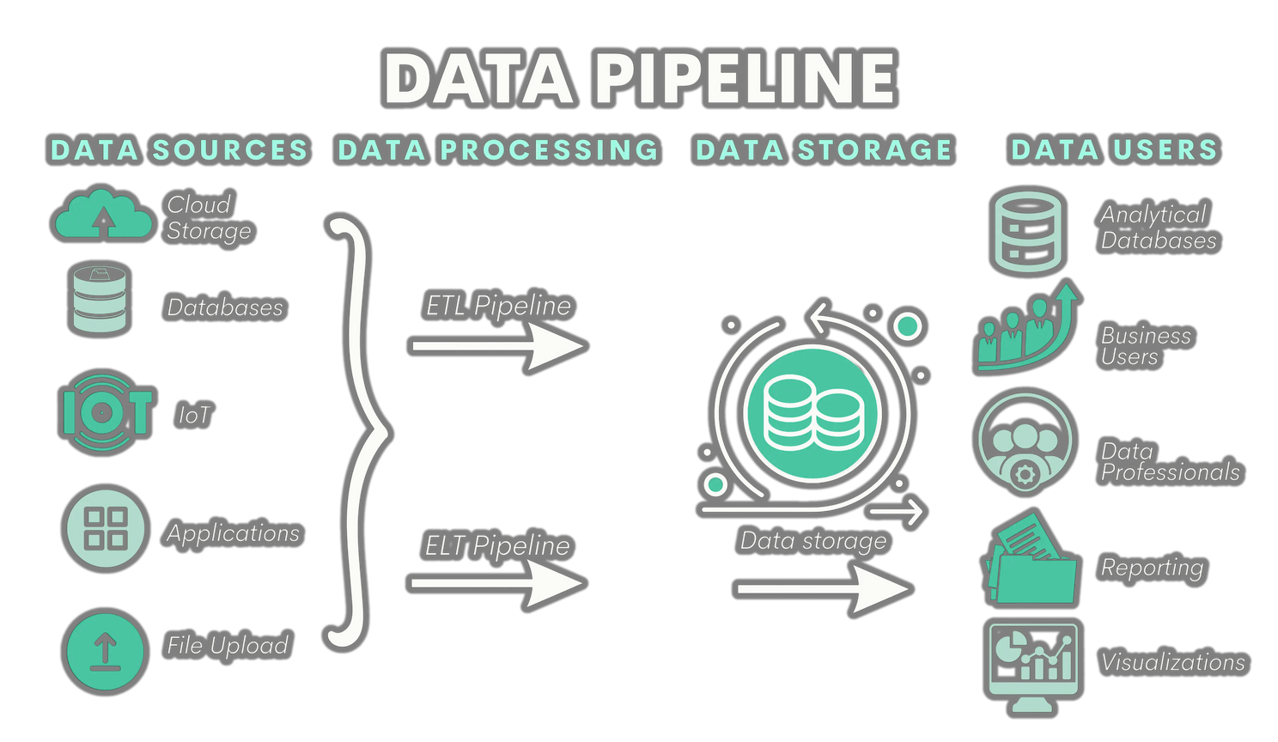
Key Concepts in Data Engineering
Data Pipeline: A set of processes that move data from one system to another.
ETL (Extract, Transform, Load): The process of extracting data from sources, transforming it into a usable format, and loading it into storage.
Data Lake: A storage repository that holds vast amounts of raw data in its native format.
Data Warehouse: A system used for reporting and data
analysis, storing integrated data from multiple sources.
DATATECH LABS.

Slide 9
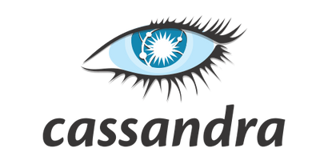
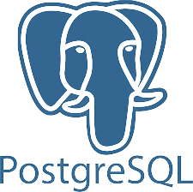






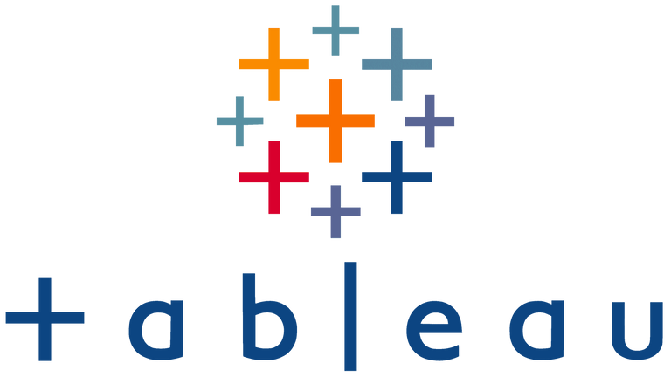
Tools and Technologies
Apache Hadoop
Apache Spark
Apache Kafka
Apache Flink
Apache Airflow
SQL Databases (e.g., MySQL, PostgreSQL)
NoSQL Databases (e.g., MongoDB, Cassandra)
Business Intelligence (BI) Tools
DATATECH LABS.

Slide 10




Course Tools and Setup
Python
Jupyter Notebook
Docker
GitHub
Instructions for installing and setting up the tools
DATATECH LABS.

Slide 11

Hands-on:
Introduction to Python for Data Engineering.
Setting up your environment.
DATATECH LABS.

Slide 12
Setting Up Your Environment
Download Python: python.org
Download Docker Desktop: docker.com
Create your python virtual environment with command:
`python3 -m venv <env_name>`
Create your GitHub account: github.com
Create a new repository for the course.
Push your Jupyter Notebook to the repository.
DATATECH LABS.

Slide 13
Data Modeling and Architecture
DATATECH LABS.

Slide 14
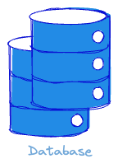
First: What is a Database?
A database is an organized collection of structured information, or data, typically stored electronically in a computer system.
Key Components:
Data: Raw facts or figures, which might include numbers, text, or multimedia.
Database Management System (DBMS): Software that interacts with users, applications, and the database itself to capture and analyze data.
Purpose:
Databases are used to store, retrieve, and manage data efficiently.
They support operations such as data querying, updating, and administration.
DATATECH LABS.

Slide 15
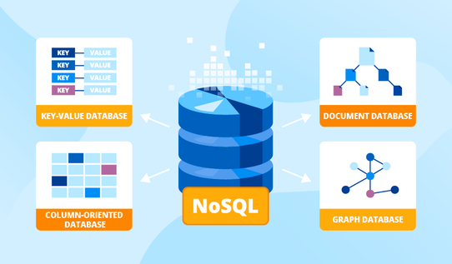
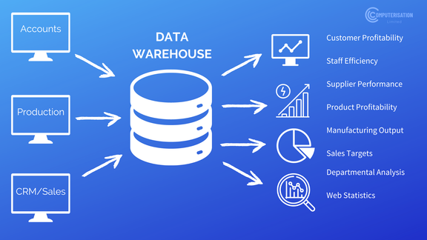

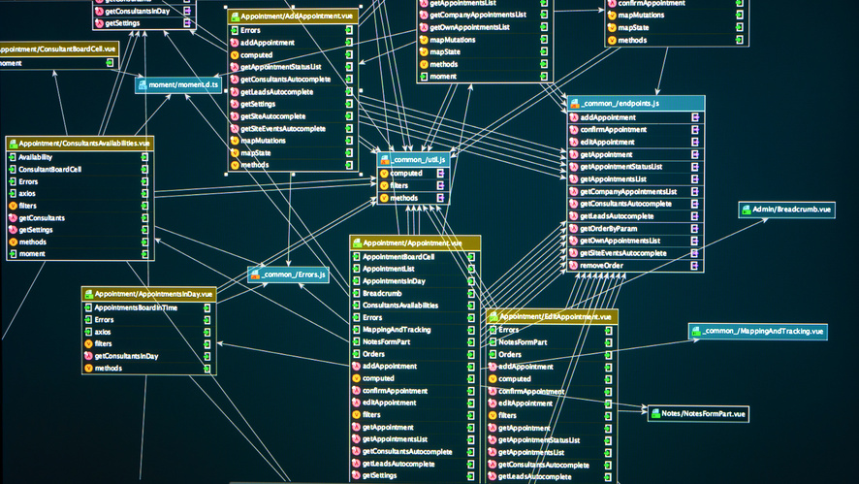
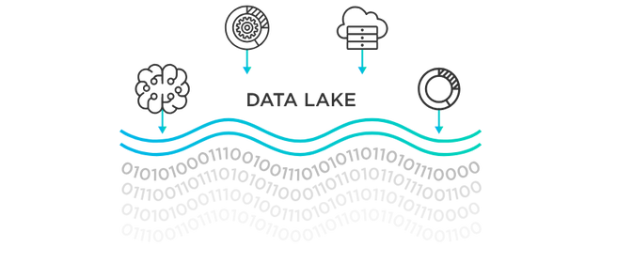
Data Storage Systems
The type of data storage that is used depends on the volume, velocity, and variety of the data. Common data storage options include:
Relational Databases. Structured data
NoSQL Databases. Unstructured data
Data Warehouses.
Structured Big data
Data Lakes.
Big data
DATATECH LABS.

Slide 16
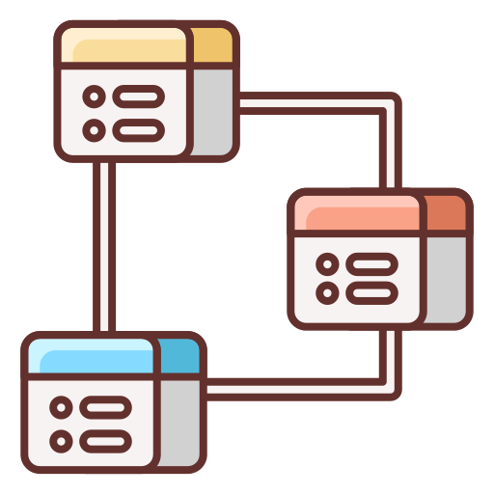
Data Modeling Concepts
Definition: Data Modeling is the process of creating a data model to visually represent the structure of data.
Discussion Point: Why is data modeling important in database design?
DATATECH LABS.
Notes:
note 15

Slide 17
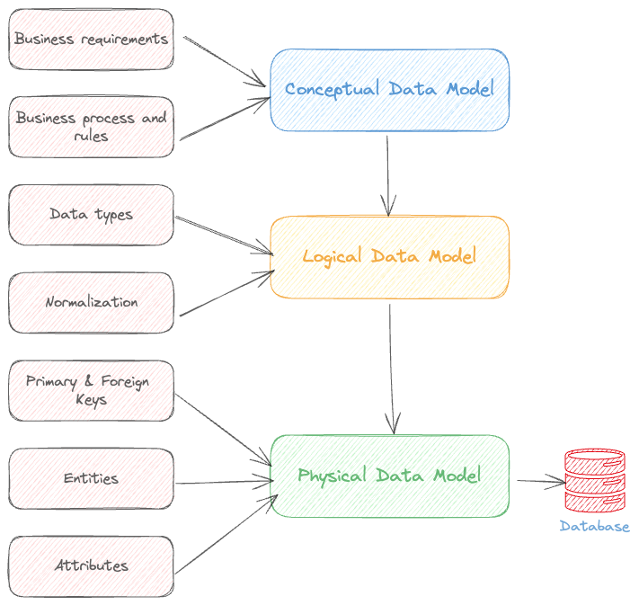
Types of Data Models
Conceptual Data Model: High-level overview of data entities and relationships.
Logical Data Model: Detailed description of data entities, attributes, and relationships.
Physical Data Model: Specification of data storage and access methods.
DATATECH LABS.
Notes:
note 16

Slide 18
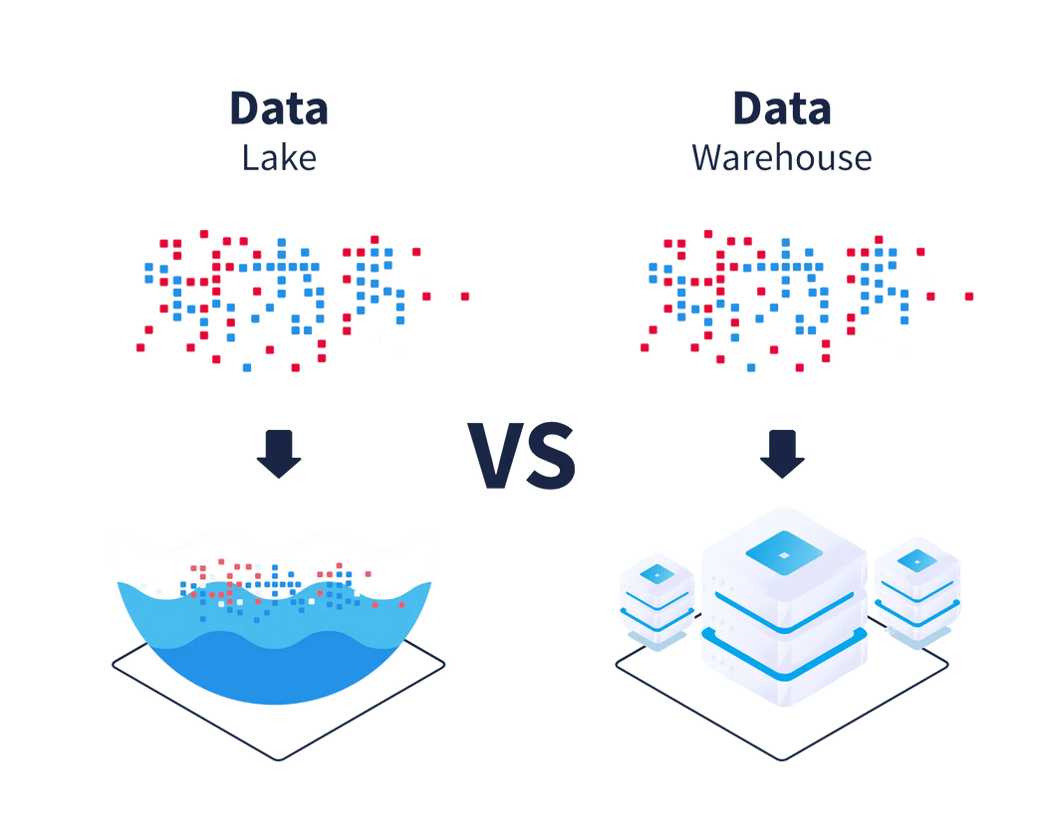
Defining Data Warehouses and Data Lakes
Both are storage tools, but:
Data Warehouse: A centralized repository that stores structured integrated data from multiple sources, optimized for querying and analysis. Stores structured data, schema-on-write, optimized for read operations.
Data Lake: Raw data, schema-on-read, optimized for
storage and batch processing.
Discussion Point: When would you choose a data lake
over a data warehouse?
DATATECH LABS.

Slide 19

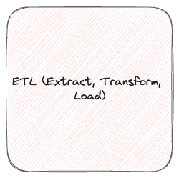
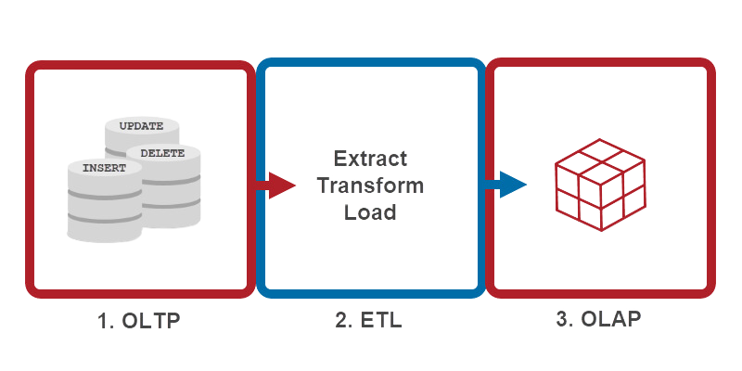
OLTP vs. OLAP
OLTP (Online Transaction Processing): Systems optimized for managing transactional data (e.g., our operational database).
OLAP (Online Analytical Processing): Systems optimized for analytical queries and reporting (e.g., data warehouse).
Transactional
Analytical
DATATECH LABS.

Slide 20
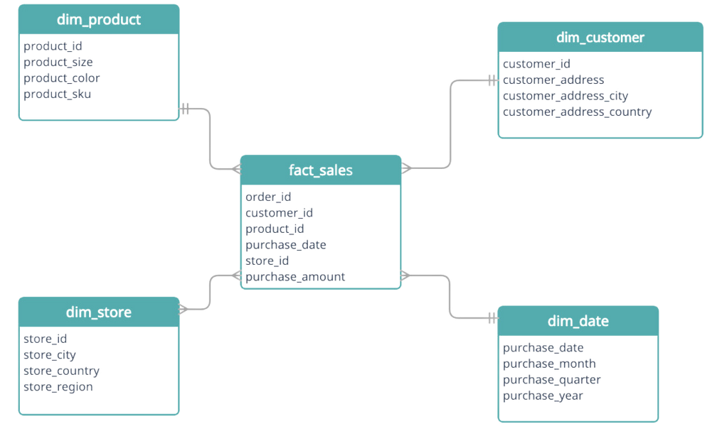
Star & Snowflake Schemas
Star Schema: A type of database schema used in data warehousing. It consists of a central fact table connected to multiple dimension tables, resembling a star.
Structure:
Fact Table: Central table containing quantitative data (e.g., sales, revenue).
Dimension Tables: Surrounding tables with descriptive attributes (e.g., time, product, location).
Advantages:
Simpler queries
Faster performance for read operations
Easy to understand and maintain
DATATECH LABS.

Slide 21
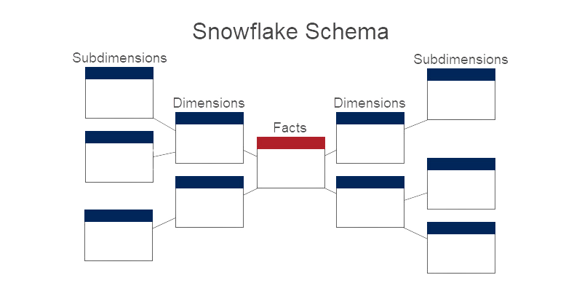
Star & Snowflake Schemas
Snowflake Schema: A more normalized version of the star schema where dimension tables are further broken down into related sub-dimension tables.
Structure:
Fact Table: Same as in the star schema.
Normalized Dimension Tables: Hierarchically organized dimension tables.
Advantages:
Reduced data redundancy
More organized and efficient storage
Considerations:
Slightly more complex queries
May have slower query performance
compared to a star schema
DATATECH LABS.

Slide 22
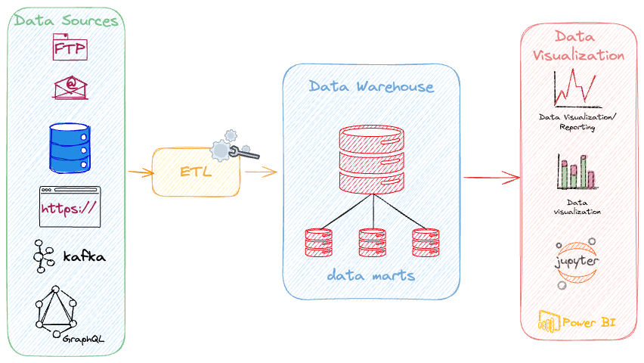
Data Warehouse Architecture
Source Systems
ETL Processes
Data Warehouse
Data Marts
BI Tools
DATATECH LABS.

Slide 23
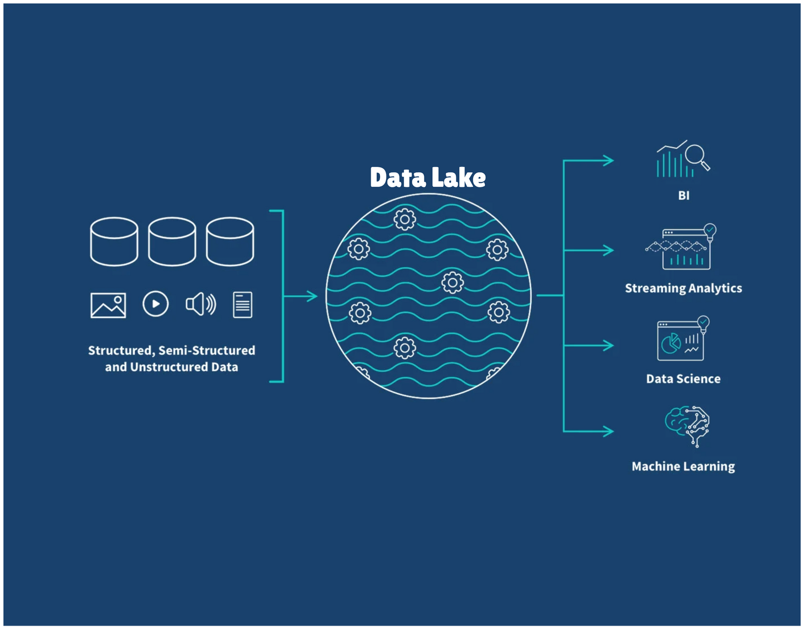
Data Lake Architecture
Data Sources
Ingestion Layer
Storage Layer
Processing Layer
Consumption Layer
DATATECH LABS.

Slide 24
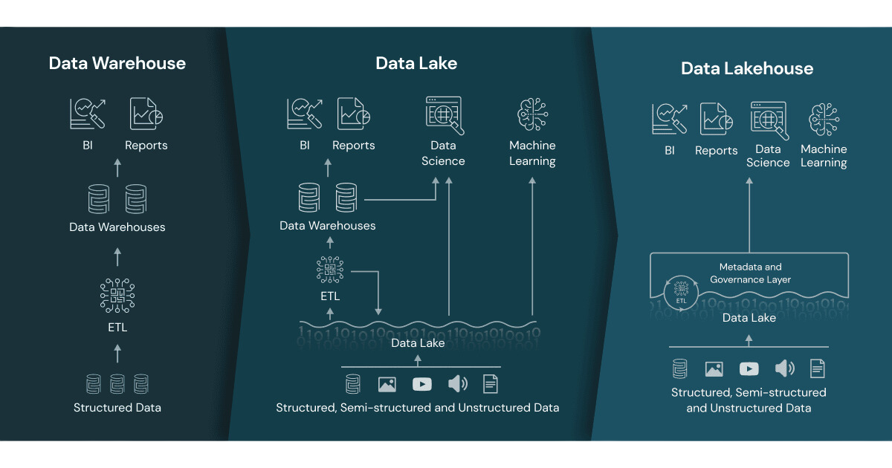
Combining Data Warehouses and Data Lakes
Source Systems
ETL Processes (Ingestion and/or Processing Layer)
Data Lake Storage
Processing Layer (another Layer)
Data Warehouse
Data Marts
BI Tools (Consumption Layer)
DATATECH LABS.

Slide 25

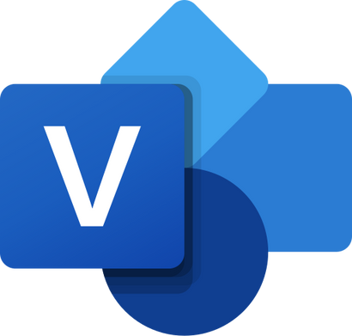

Tools for Data Modeling
DBeaver
Draw.io
ER/Studio
ERwin Data Modeler
Microsoft Visio
DATATECH LABS.

Slide 26
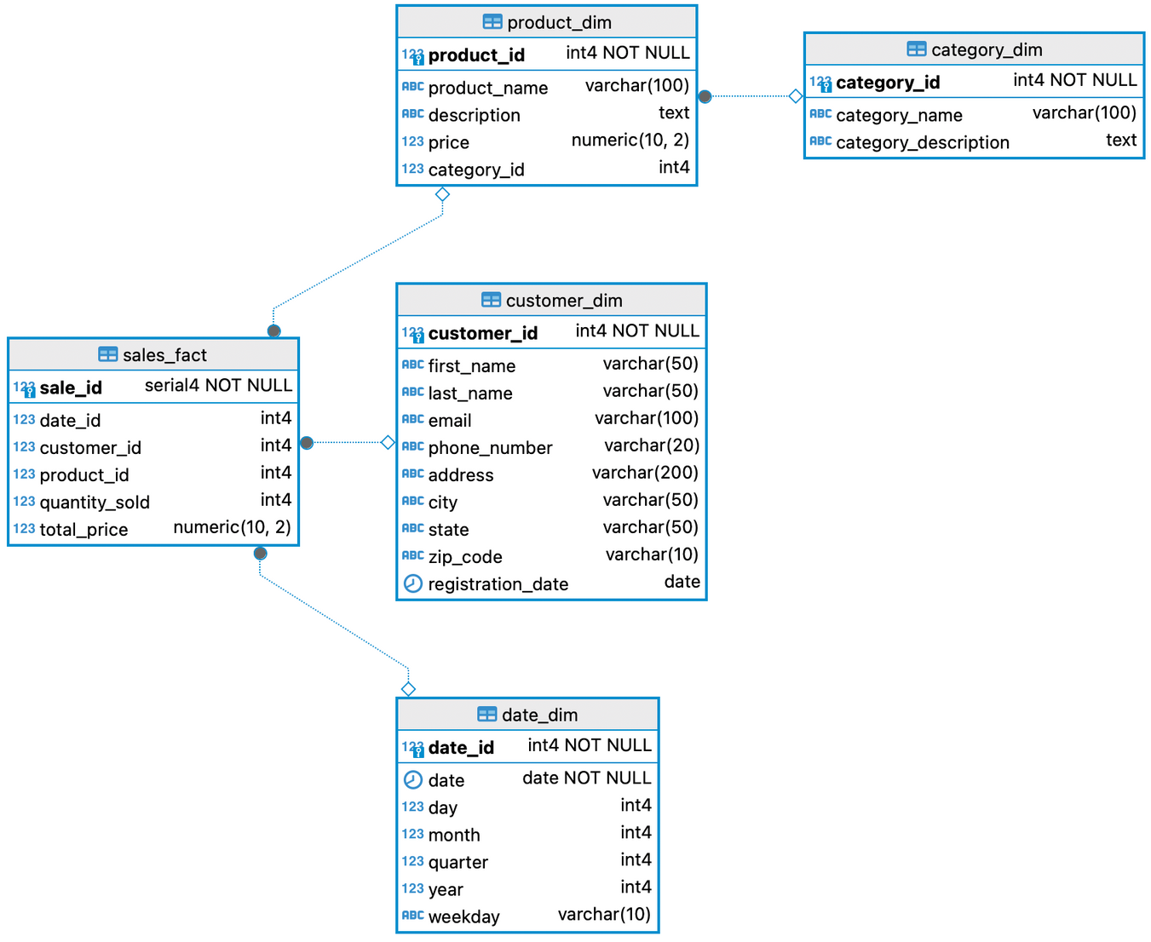
Case Study: Designing a Data Model
E-commerce business data model
Identify entities, attributes, and relationships
DATATECH LABS.

Slide 27

SQL: Structured Query Language
Definition: a standard language for accessing and manipulating databases.
Query: Is a question or inquiry about a set of data. We use SQL to retrieve meaningful and relevant information from databases.
SQL stands for Structured Query Language.
SQL lets you access and manipulate databases
DATATECH LABS.

Slide 28
What is SQL Used for?
CRUD Operations: CREATE, READ, UPDATE, and DELETE records from databases.
SQL can create new databases.
SQL can create new tables in a database.
and more...
.sql
SELET column_a, column_b
FROM table
WHERE column_a > “value”
;
DATATECH LABS.

Slide 29
Hands-on:
Creating a Data Model and Designing a Data Warehouse
Objective: Design a simple data model and implement a basic data warehouse schema using SQL.
DATATECH LABS.

Slide 30
Q&A and Discussion
DATATECH LABS.

Slide 31

MEET OUR TEAM
Omar AlSaghier
Sr. Data Engineer
DATATECH LABS.

Slide 32







DATATECH LABS.
THANK YOU
OUR CONTACT
DataTechLabs
datatechlabs.ai@gmail.com
datatechlabs.ai
Amman, Jordan

Slide 33
template
Lorem
DATATECH LABS.

